Slide 1

Maths at Hazlemere
November 2024

Slide 2
Give you an insight into how maths is taught at Hazlemere,
To share the different methods of learning
To see how maths learning progresses through the school
To take away some ideas of how you can support your child at home.

Slide 3
National Curriculum
The National Curriculum 2014 aims to ensure that all pupils:
become fluent in the fundamentals of mathematics, including varied and frequent practice with increasingly complex problems over time, so that pupils develop conceptual understanding and the ability to recall and apply knowledge rapidly and accurately
reason mathematically by following a line of enquiry, conjecturing relationships and generalisations, and developing an argument, justification or proof using mathematical language
can solve problems by applying their mathematics to a variety of routine and non-routine problems with increasing sophistication, including breaking down problems into a series of simpler steps and persevering in seeking solutions

Slide 4
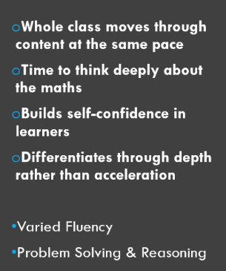
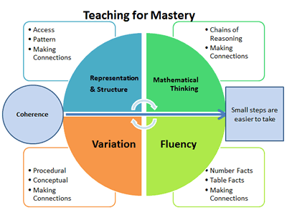
Mastery Approach

Slide 5
Daily Maths
Maths is taught daily at Hazlemere Church of England School. Each day starts with an early morning maths skills session where children practice fluency of calculations and mental maths skills. This is followed by an hour’s maths lesson.
Lessons are planned following the Herts for Learning Essential maths scheme. Teachers use sequences of learning, which are written as a spiral curriculum in which learning is built upon step by step, to plan engaging and challenging lessons for all.
By following this scheme, it ensures progression and coverage through the primary phase. Teachers also supplement learning activities from a wide range of resources ensuring adequate and support is given to all children.

Slide 6
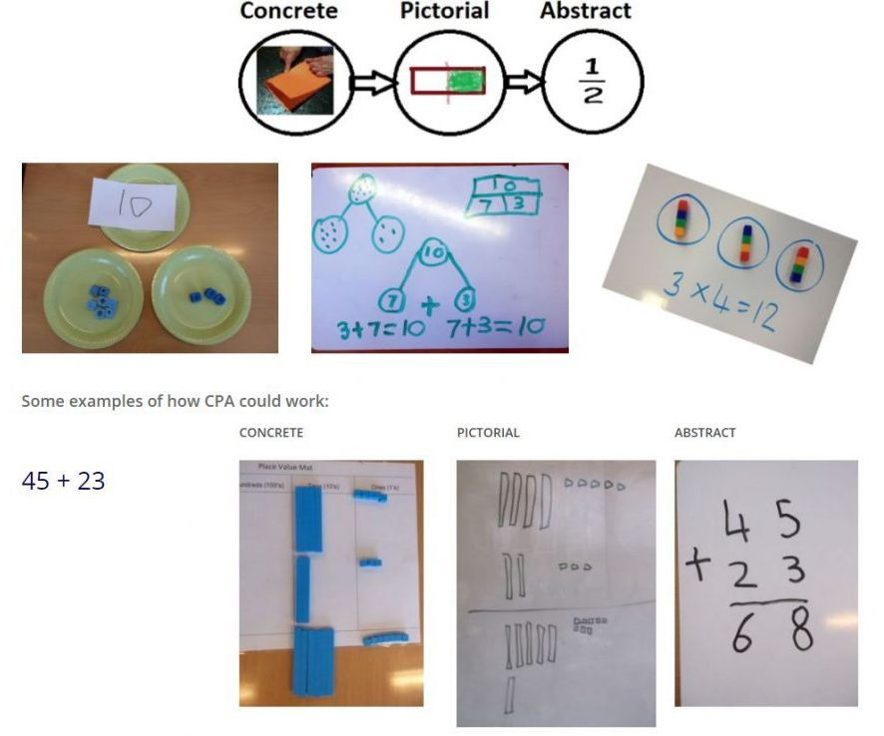
Multiple Representations For All
Concrete – children have the opportunity to use concrete objects and manipulate them to help them understand and explain what they are doing.
Pictorial – children then build on this concrete approach by using pictorial representations, which can then be used to reason and solve problems.
Abstract – with the foundations firmly laid, children can move to an abstract approach using numbers and key concepts with confidence.
Notes:
Objects, pictures, words, numbers and symbols are everywhere. The mastery approach incorporates all of these to help children explore and demonstrate mathematical ideas, enrich their learning experience and deepen understanding. Together, these elements help cement knowledge so pupils truly understand what they’ve learnt.
All pupils, when introduced to a key new concept, should have the opportunity to build competency in this topic by taking this approach. Pupils are encouraged to physically represent mathematical concepts. Objects and pictures are used to demonstrate and visualise abstract ideas, alongside numbers and symbols.

Slide 7
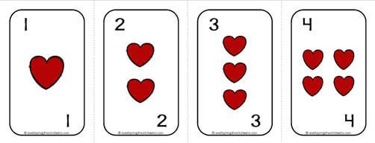
Number at the Heart
A large proportion of time is spent reinforcing number to build competency and fluency. Number is at the heart of learning, with more time devoted to this than other areas of mathematics. It is important that pupils secure these key foundations of Maths before being introduced to more difficult concepts.
Subitising – recognising numbers without counting
Number bonds to 10, 20 or 100
Recall multiplication and division facts including doubles and halves
More than or less than
Ordinal numbers
Counting – recognising patterns
Notes:
Maths skills TTRS number sense in KS1 oral rehearsal in lessons and throughout the day.

Slide 8
Early Maths
Children learn to count confidently, develop a deep understanding of the numbers to 10, the relationships between them and the patterns within those numbers.
Frequent and varied opportunities are provided to build and apply this understanding - such as using manipulatives, including small pebbles and tens frames for organising counting - children develop a secure base of knowledge and vocabulary from which mastery of mathematics is built.
Throughout the early years, t is important that children develop positive attitudes and interests in mathematics, look for patterns and relationships, spot connections, ‘have a go’, talk to adults and peers about what they notice and not be afraid to make mistakes.

Slide 9
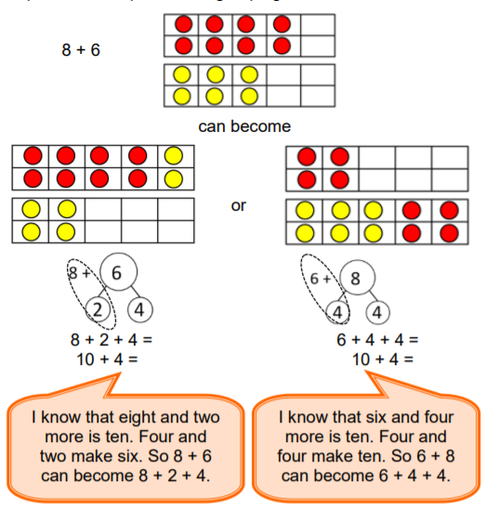
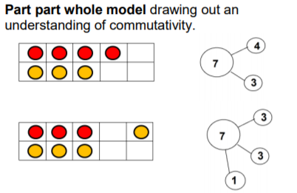
Addition
Year 2
Year 1

Slide 10
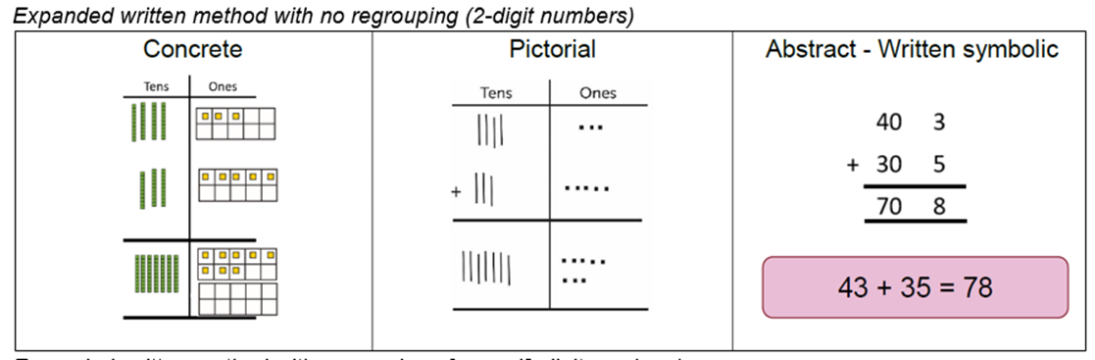
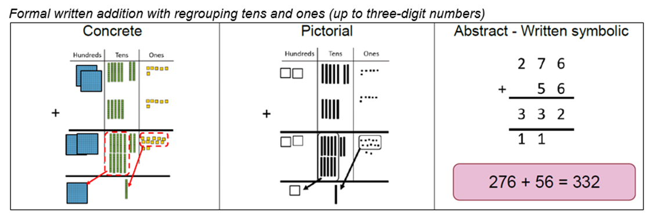
Year 2
Year 3

Slide 11
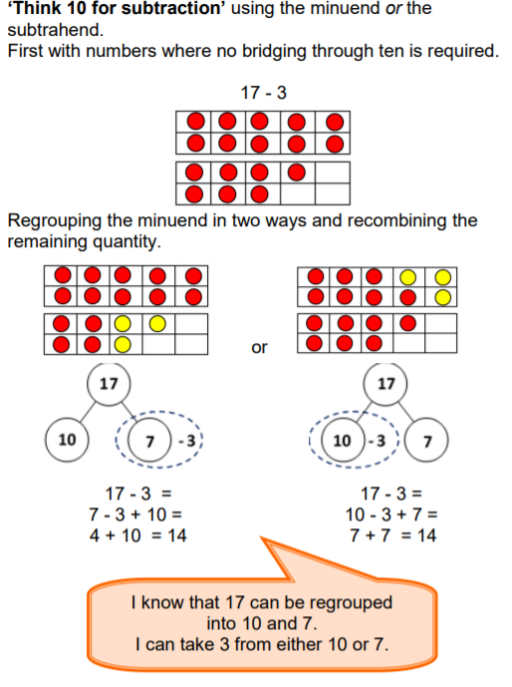
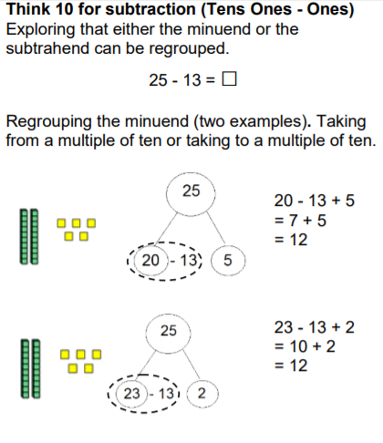
Subtraction

Slide 12
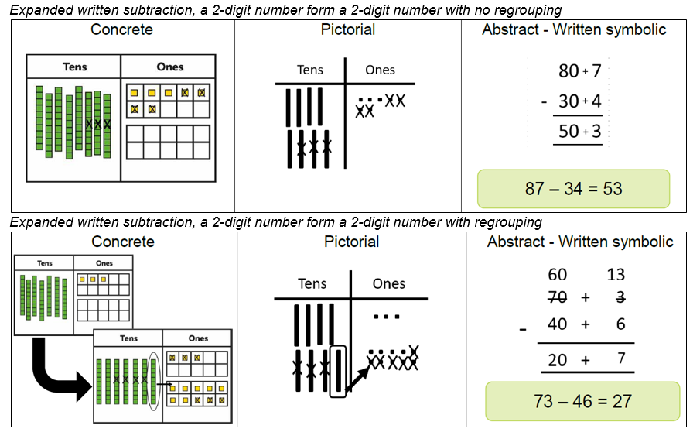
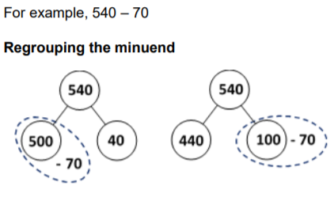
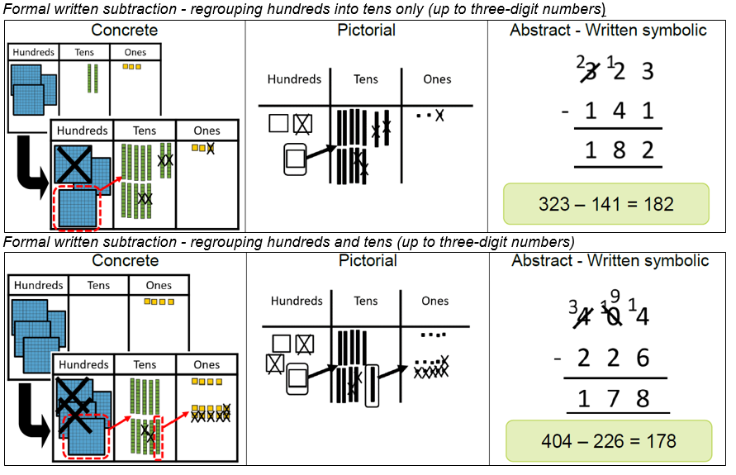
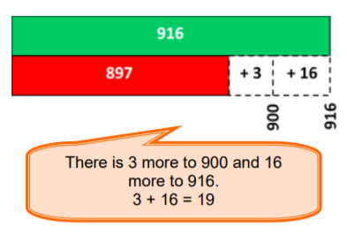

Slide 13
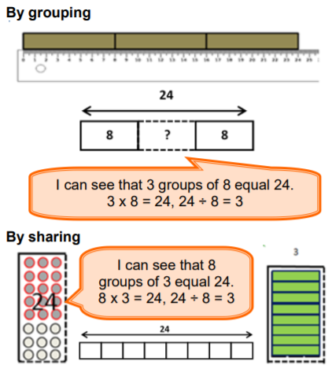
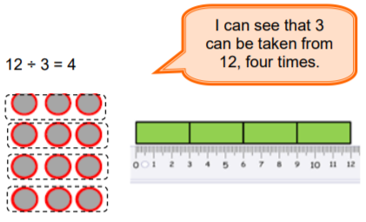
Division

Slide 14
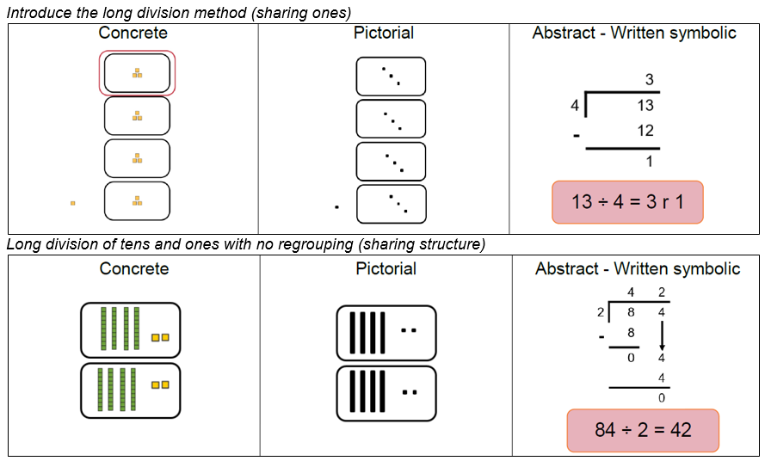
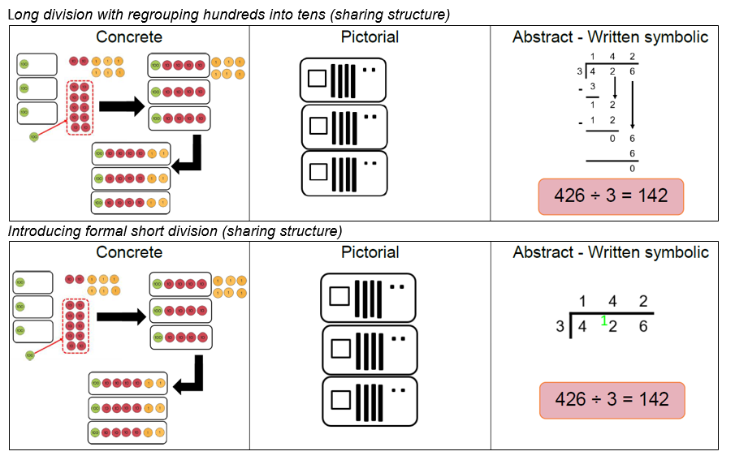
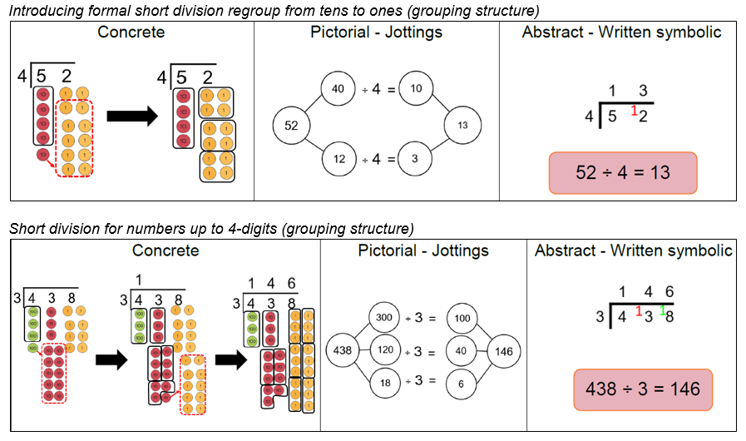

Slide 15
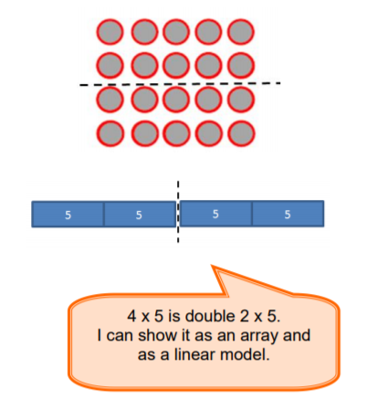
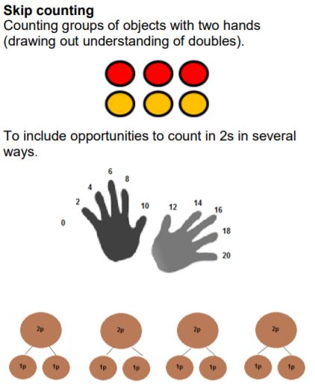
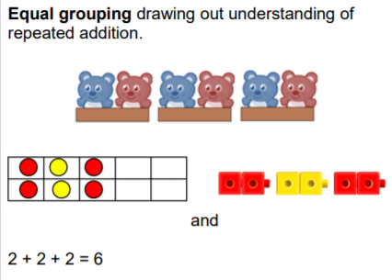
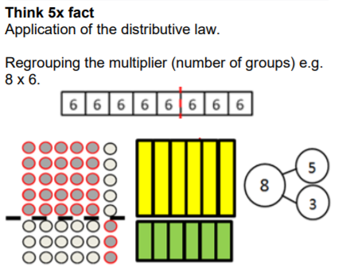
Multiplication

Slide 16
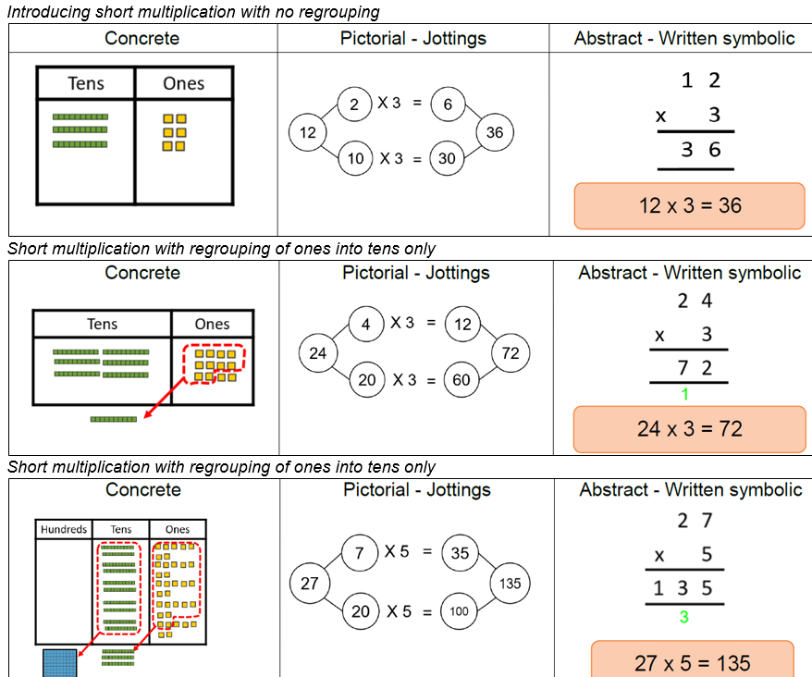
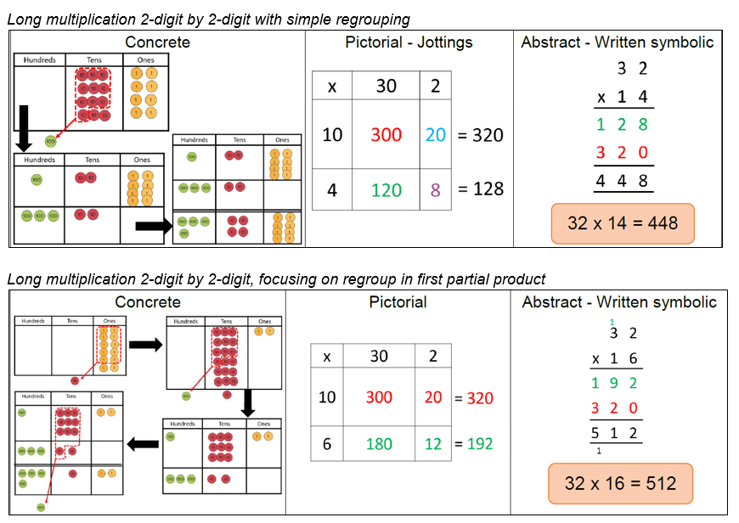

Slide 17
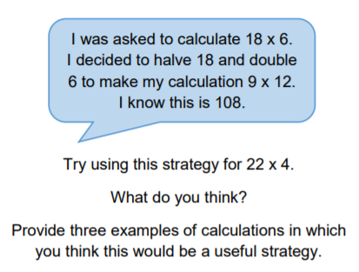
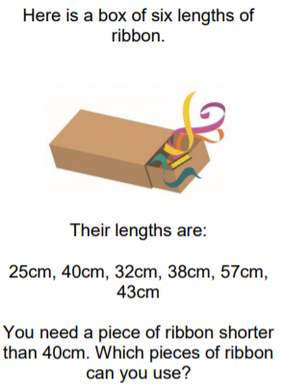
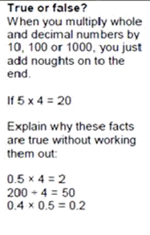
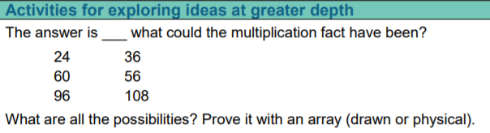
Problem Solving and Reasoning

Slide 18
Helping Your Child
Be positive
Point out the maths in everyday life
Praise your child for effort
Play games together
Talk and think like a mathematician
Learn their maths methods
Practise reading the time
Involve them in problem solving
Learn rhymes and songs
Times tables – Practice Practice Practice!
Notes:
I think it’s really important that they know that if they repeatedly say ‘I can’t do maths’ ‘I hated maths at school’ ‘I was rubbish at maths at school’ ‘that’s not how I was taught it’ ‘why don’t they just teach it the easy way’ that it reinforces that feeling in their children and puts up real barriers to learning. I (very politely and gently!) brought this up in a parent workshop I led last year and many didn’t realise the impact of their own attitude towards learning on their children. The response was really positive!

Slide 19




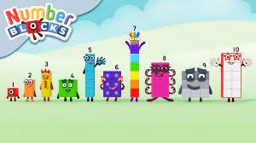
Useful Websites

