Slide 1
Supporting Your Child Through Transition to a New Year Group.
Mrs Brocklehurst and Dr. Luiza Salciuc

Slide 2
Understanding Transition
Transitioning to a new year group can be both exciting and scary for children. It involves adapting to new teachers, classmates, and subjects. Children learn strategies that enable them to cope with the environment in which they find themselves. For most children those strategies stand them in good stead for dealing with subsequent life changes. But a significant minority of children, develop ways of coping that are much less well suited to the demands of school.
<suggested search for images: "children transitioning to new school year">
Notes:
Dicsuss – school avoidance
Tummy ache
Physical signs of stress – headache, digestive problems, increased heart rate, breathlessness.

Slide 4
Encouraging Open Communication
Encourage your child to share their thoughts and feelings about moving up to a new class. Create a safe space for these conversations, where they feel comfortable expressing concerns. Listening to their worries and providing guidance can foster confidence and ease their transition worries.
<suggested search for images: "child speaking to parent">
Notes:
Young minds – find you feet resource and video’s
Twinkle – KS1 – KS2

Slide 5
Establishing Routines
As children transition, it's beneficial to establish consistent routines at home. Routines provide a sense of stability and comfort. Encourage organisational skills by helping your child plan their homework and daily tasks, which can help them feel more prepared for what lies ahead in the new year.
<suggested search for images: "child studying with a schedule">
Notes:
Use transition booklets to support –Young minds

Slide 6
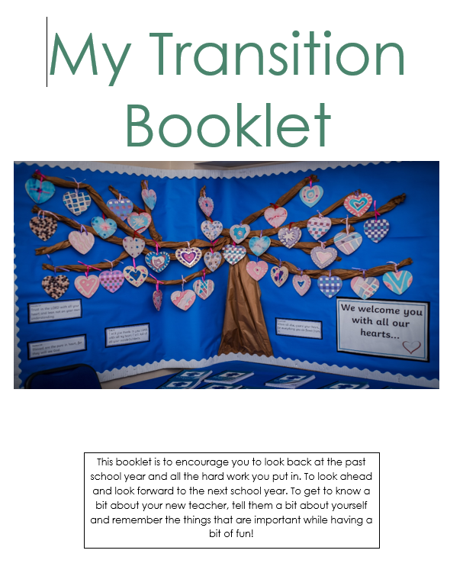

Slide 7
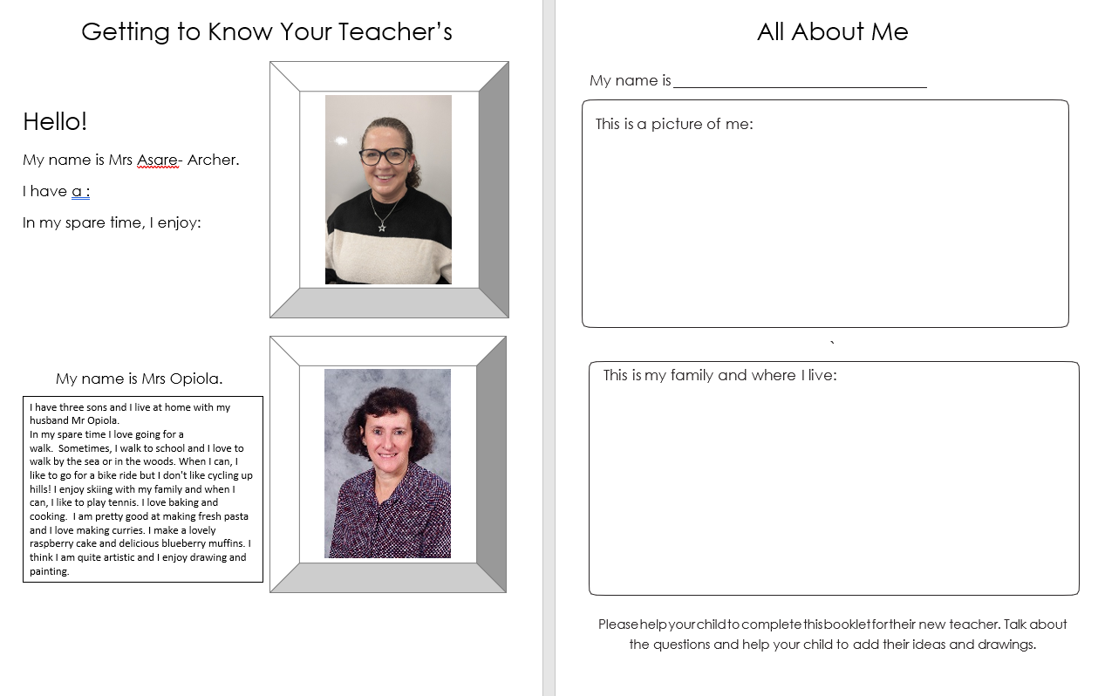

Slide 8
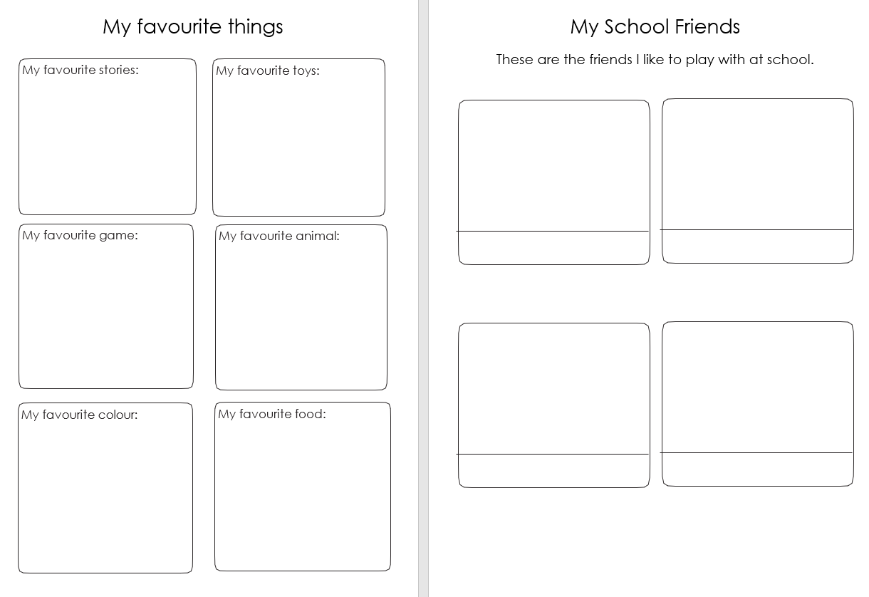

Slide 9
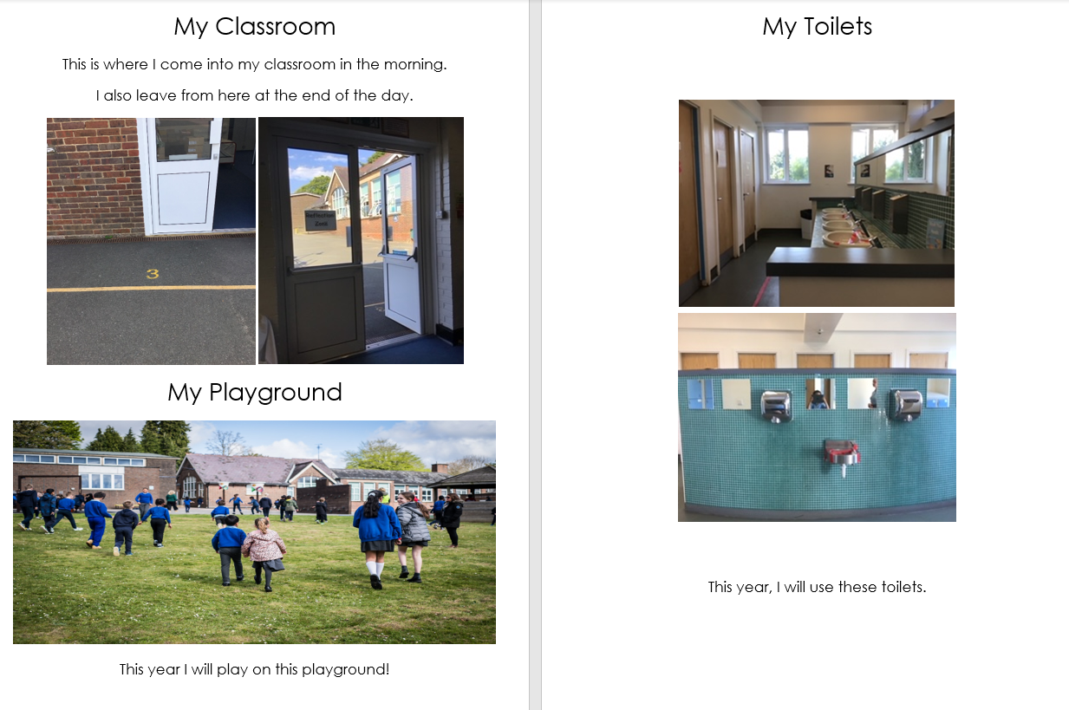

Slide 11
