Slide 1
Building resilience in children
Dr. Luiza Salciuc
Educational Psychologist

Slide 3
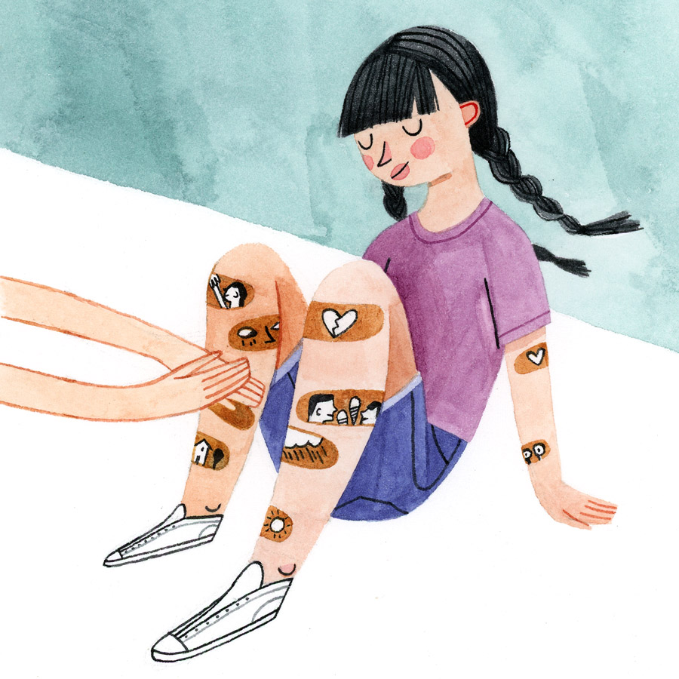
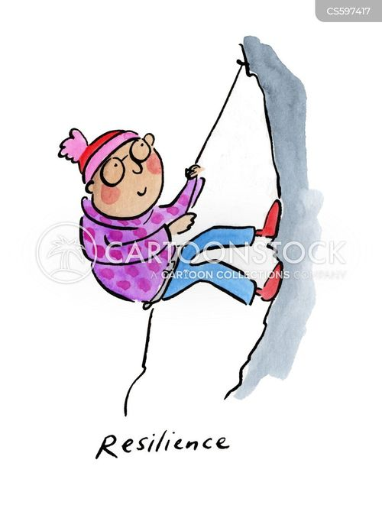
We can do this through co-regulation in activities with others. Think of soothing a crying child, running or walking side-by-side, or coaching a teenager to prepare for a test.
Building resilience is likely the most important task we have, for ourselves and our kids. You might think that resilience is something you have, or you don’t, like eye colour, but resilience can be built just like a muscle.
It starts with knowing the strengths we already have from our life experiences and bolstering the skills and mindsets we possess to regulate our emotions, our actions, our behaviour.

Slide 4
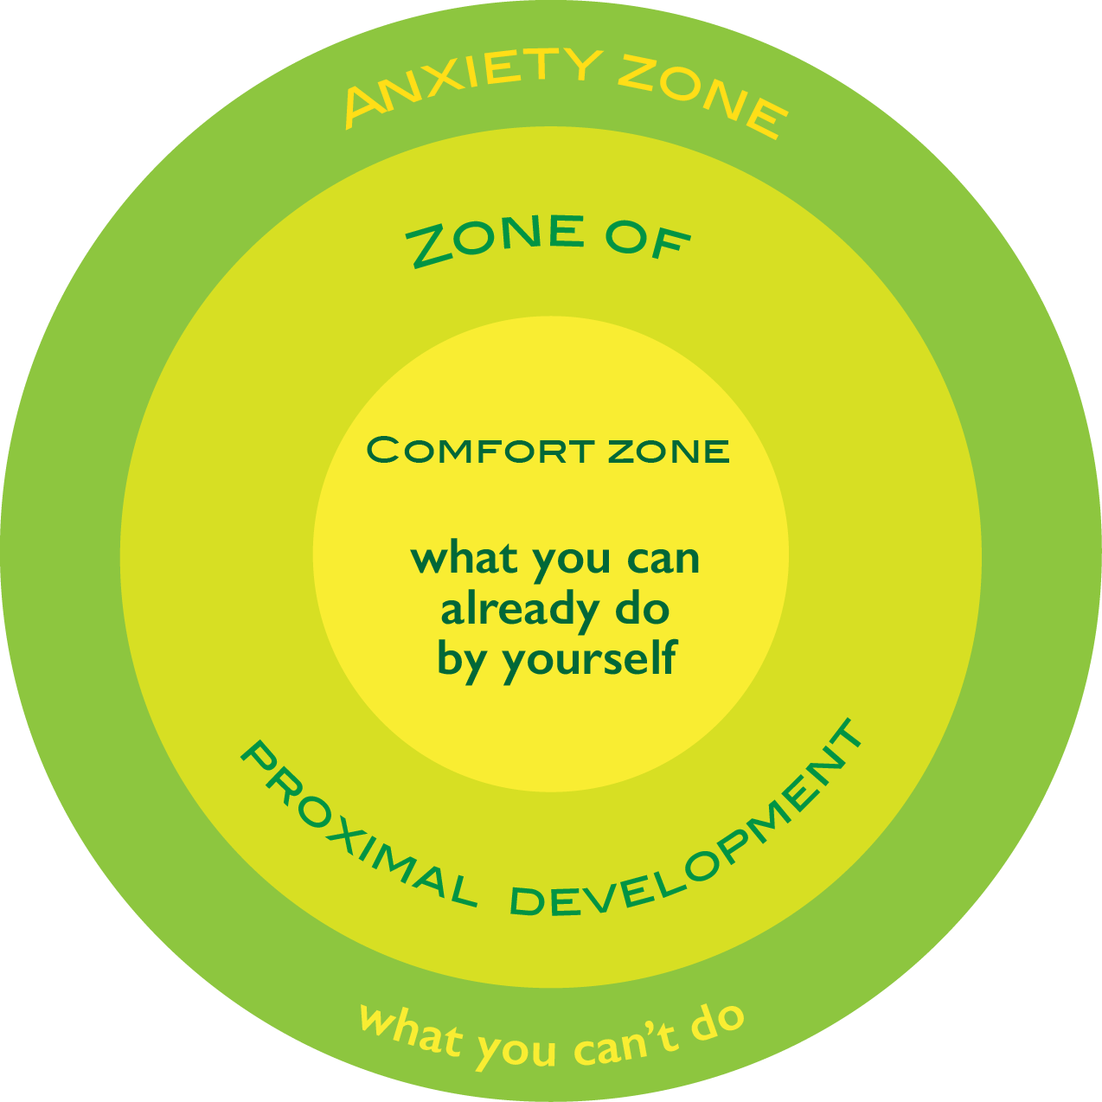

Slide 5
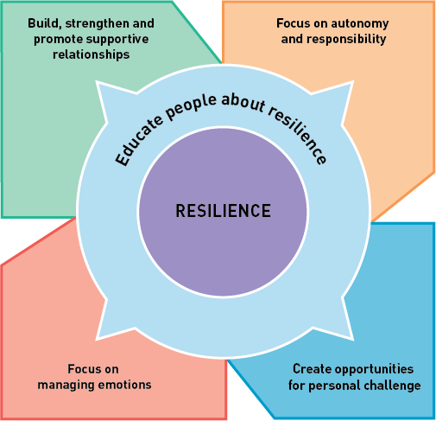

Slide 6
Positive self-talk
As soon as children begin to talk, they talk to themselves.
Children make use of self-talk as a tool in regulating their behaviour and thinking (Thibodeaux et al., 2019).
We want to create an awarenss of how they speak and think about themsleves. Poisitive self-talk helps with efficient learning, academic achievement, social and emotional skills and boosts their confidence
Helping students be mindful of how they talk about themselves, and their abilities can be influential in reducing anxiety. Positive statements made by teachers were found to be directly related to positive self-talk and to Maths, Reading and learning self- concepts.

Slide 7
